Slide 1
Azure IaaS Part 2

Slide 2
Agenda
Introduction to Storage
Add Data Disk on existing VM
Traffic Manager
Virtual Networks

Slide 3
Virtual Machines

Slide 4
Demo: Managing VMs using Azure portal
Notes:
Demo: Provisioning VM
Prerequisites:
A Windows Server 2012 is already provisioned.
Steps:
Open Ibiza portal and click the NEW button at the lower-left corner.
Show the short list of resources. Explain that I can directly create popular resources here such as a Windows Server 2012.
Click on the Everything link.
In Gallery blade, open the Virtual machines category.
Scroll down the view and show images of different types (refer back to slide 9).
Click on Windows Server 2012 R2, and then click the Create button in the overview blade. For non-Microsoft focused audience, consider to pick a Linux image instead.
Fill in the Create VM form and click on the Create button to provision the VM. Explain this will take a few minutes.
Open the already provisioned VM.
Scroll down the blade to show various of information available on the blade.
Click on the Extensions tile.
On the Extensions blade, click on the ADD icon to bring up the extension list. Introduce that VM extensions are installable components to customize VM instances.
Switch to slides to continue with VM extension introduction.

Slide 5
Image Mobility
On-Premises
Cloud
MyApp.vhd
Notes:
Slide Objective:
Explain the benefits of image mobility
Notes:
One of the key benefits of IaaS is flexibility and control. The Microsoft Azure solution provides the capability of not only moving VHDs TO the cloud but also allows you to copy the VHD back down and run it locally or on another cloud provider. Great for testing out production issues or any other need where you require a copy of the production server.

Slide 6

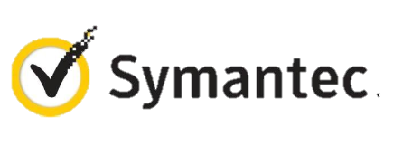




VM Extensions
Installable components to customize VM instances
Enable various DevOps scenarios
Can be added, updated, disabled or removed at any time
Managed via portal, PowerShell and Management APIs
Microsoft Azure
Notes:
Slide Objective:
Introduce VM extensions.
Speaker Notes:
No matter how big the image gallery is, your projects may have specific needs that can’t be satisfied by standard images.
Some components such as anti-virus, configuration management agents are required on most machines for compliance and management purposes.
This allows use to innovate faster to meet with your project needs. And you have flexibility to pick and combine extensions for your goals.
Point out some of existing extensions:
Custom Script Extension, which allows you to download and execute PowerShell scripts.
Chef Extension and Puppet Extension for automated management at scale.
Symantec Endpoint Protection etc. for protection.
Docker (Linux only).
Visual Studio Remote Debugger.

Slide 7
Data Persistence
OS Disks
Data Disks

Slide 8
Disks and Images
OS Images
Microsoft
Partner
User
Base OS image for new Virtual Machines
Sys-Prepped/Generalized/Read Only
Created by uploading or by capture
Disks
OS Disks
Data Disks
Writable Disks for Virtual Machines
Created during VM creation or during upload of existing VHDs.
Notes:
Slide Objective:
Explain the differences between disks and images with VMs

Slide 9
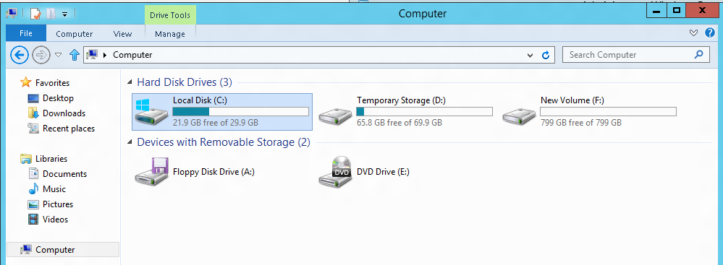
VM disk layout
OS Disk
Persistent
SATA
Drive C:
Temporary Storage Disk
Local (Not Persistent)
SATA
Drive D:
Data Disk(s)
Persistent
SCSI
Customer Defined Letter

Slide 10
Temporary Drive Guidance
Never Place Critical Unreplicated Data on Temp Drive!!
Use for SQL TempDB and Buffer Pool Extension on D-Series and G-Series VM Sizes Only (SSD Temp Disks)
Detailed instructions: http://blogs.technet.com/b/dataplatforminsider/archive/2014/09/25/using-ssds-in-azure-vms-to-store-sql-server-tempdb-and-buffer-pool-extensions.aspx
Use Scheduled Tasks to Configure Temporary Disk
Test Scheduled Tasks via Resize VM Operation

Slide 11
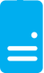
Persistent Disks and Highly Durable
Microsoft Azure Storage (Disaster Recovery)
Microsoft Azure Storage
Virtual
Machine
Virtual Machine
Notes:
Slide Objective:
Explain how disks are durable and how Microsoft Azure storage works
Notes:
The OS and Data Disks are stored in Microsoft Azure storage. So in addition to the data being persistent you also get the benefits of storage which means your VHD is replicated 3X’s locally and also 3X’s in a separate data center in the same region (geo-replication)

Slide 12
Demo: Add a Data Disk to existing VM
Notes:
Demo: VM Extension
Prerequisites:
Azure PowerShell v0.8 or higher has been installed and configured.
Desired Azure subscription has already been selected.
A storage account has been provisioned under the same Azure subscription.
A scripts container has been created under the storage account with public read access.
A helloworld.ps1 PowerShell script has been uploaded to the container. The content of the script is a single line: write-output “Hello World!”
PowerShell environment has been set with large font for easy reading.
A Windows Server 2012 VM has been provisioned.
Steps:
In Azure PowerShell, issue command: Get-AzureVMAvailableExtension | Format-Table -Property ExtensionName, Publisher
The above cmdlet lists existing extensions. Next we’ll see how we can inject an extension to a running VM instance. In the last demo you’ve seen that you can achieve this using Azure Management Portal. Here we’ll do it using PowerShell. In this case, we’ll install Custom Script Extension to an existing Windows Server 2012 VM.
Issue the following cmdlets to get a reference to the virtual machine instance:
$serviceName = “[cloud service that hosts the VM]”
$vmName = “[name of the VM]”
$vm = Get-AzureVM –ServiceName $serviceName –Name $vmName
Next, issue command Get-AzureVMExtension –VM $vm. This lists VM extensions that are currently installed on the VM.
Use the following cmdlet to enable Custom Script Extension, and instruct it to download and execute the helloworld.ps1 (this takes about 20-30 seconds):
Set-AzureVMCustomScriptExtension -ContainerName scripts -StorageAccountName '[your storage account name]' -VM $vm -FileName ‘helloworld.ps1' -Run ‘helloworld.ps1' | Update-AzureVM -Verbose
6. Next, we’ll retrieve and display the script execution result:
$status = Get-AzureVM -ServiceName $serviceName -Name $vmName
$result = $status.ResourceExtensionStatusList.ExtensionSettingStatus.SubStatusList | Select Name, @{"Label"="Message";Expression = {$_.FormattedMessage.Message }}
$result |fl
(see screenshots in hidden slides for references)
(see this blog: http://azure.microsoft.com/blog/2014/07/15/automating-sql-server-vm-configuration-using-custom-script-extension/ for more details on Custom Script Extension)

Slide 13
Virtual Machine Availability
Meaning of 9’s
Fault domains, update domains and availability sets
Load balancing

Slide 14
Load balancing
Load balancing
Multiple VMs share the workload via public facing endpoints
Internal Load balancing
Load balancing between VMs that don’t have public facing endpoints
Microsoft Azure
Internet
Public VIP
Customer vNet
External Load Balancer
Internal Load Balancer
Microsoft Azure
Back end
Front end

Slide 15
Traffic Manager
Load balancing
Failover
US West
North Europe
Microsoft Azure
North America
Europe

Slide 16
Virtual Networks

Slide 17
Azure Virtual Networks
A protected private virtual network in cloud
Extend enterprise networks into Azure
Cross-premises connectivity

Slide 18
Virtual Network Scenarios
Hybrid Public/Private Cloud
Enterprise app in Microsoft Azure requiring connectivity to on-premise resources
Enterprise Identity and Access Control
Manage identity and access control with on-premise resources (on-premises Active Directory)
Monitoring and Management
Remote monitoring and trouble-shooting of resources running in Azure
Advanced Connectivity Requirements
Cloud deployments requiring IP addresses and direct connectivity across services
Microsoft Azure

Slide 19






Cross-premises Connectivity
Site-to-site
Create a secure connection between your on-premises site and your virtual network
Point-to-site
Create a secure connection via VPN to your virtual network
ExpressRouteTM
Create a private connection between Azure data centers and infrastructures on your premises or in a co-location environment.
Connect at an ExpressRoute location (Exchange Provider facility)
Direct connect via a Network Service Provider
Microsoft Azure

Slide 20
Demo: Virtual Network Point-to-Site Connection
Notes:
Demo: Point-to-Site connection
Prerequisites:
Follow step 1-15 below to prepare the environment.
(http://haishibai.blogspot.com/2013/05/walkthrough-file-sharing-between-your.html)
Steps:
Run through steps 17-21 in the following steps. If time permits, you can start with step 16.
Log on to (current) Microsoft Azure Management Portal.
On command bar, click on NEW button, then select NETWORKS->VIRTUAL NETWORK->CUSTOM CREATE menu.
On Virtual Network Details page, enter network NAME as pointtosite, create or select a AFFINITY GROUP, then click next arrow.
On DNS Servers and VPN Connectivity page, check Configure Point-to-Site VPN, then click next arrow:
On Point-to-Site Connectivity page, click next arrow.
On Virtual Network Address Spaces page, click on add gateway subnet button, and then click on check icon to complete network creation.
After the virtual network has been created, open its DASHBOARD page, and the click CREATE GATEWAY icon to create the dynamic routing gateway.
Add a new Windows Server 2012 virtual machine to the virtual network. Note that when you specify user credential, make sure to use the same user id and password of your local account. This is because the virtual machine on Microsoft Azure is not under your domain controller, and we are using the same user credential on both local and virtual machines to allow file sharing.
As the virtual machine is cooking, let’s create two self-signed certificates: one for root, and another for client identification. During the following steps we’ll need to upload the root certificate to Microsoft Azure so Microsoft Azure can validate the client machine using the certificate chain.
Launch Developer Command Prompt for VS2012 as administrator. Change current folder to a folder where you want to keep the generated certificates. Here I’ll use folder c:\books.
Use command makecert -sky exchange -r -n "CN=MyFakeRoot" -pe -a sha1 -len 2048 -ss My to create root certificate.
Use command makecert -n "CN=MyLaptop" -pe -sky exchange -m 96 -ss My -in "MyFakeRoot" -is my -a sha1 to create client certificate.
Launch certmgr. Export the root certificate as a MyFakeRoot.cer file (without private key).
[Optional] if you are configuring VPN for another client, you’d need to install the client certificate on target machine.
Go back to Microsoft Azure Management Portal. On DASHBOARD page of the virtual network, click on link Upload client certificate to upload the root certificate. Note at this point the gateway should have been created.
After certificate has been uploaded, you can download and install VPN client from the DASHBOARD page (AMD64 Client link for 64-bit machines, x86 Client link for 32-bit machines).
After VPN client has been installed, you can see the VPN connection on your Windows network connection list. Click on the network to connect. When prompted by the VPN client, click Connect button to continue.
[Optional] Now you can use ipconfig/all to verify if VPN connection has been successfully established (look for PPP adapter).
Log on to the virtual machine, create a new Share folder under c:\. Share the folder with the user you specified when you created the virtual machine.
On Management Portal, record the virtual machines private IP on its DASHBOARD page. In my case the IP is 10.0.1.4.
Now you can use Explorer on your local machine and access the shared folder by \\10.0.1.4\Share.

Slide 21
Azure Resource Manager

Slide 22
Azure Resource Manager & Resource Groups
Manage resources as a single unit
Role based access and control (RBAC) on groups or resources
Billing integrated tagging on groups or resources
RESOU
R
CE G
R
OUP

Slide 23



Azure Resource Manager (ARM)
This slide could use build/animation. It builds from top to bottom. Azure/Commandline/Visual studio all hit the API to interact with resource manager groups which in turn interact with the different rest points. The link https://azure.microsoft.com/en-us/documentation/articles/virtual-machines-azure-resource-manager-architecture/
explains what this slide is supposed to get across.
RESOURCE MANAGER
Consistent management layer
Tools
SERVICE MANAGEMENT API
Microsoft Azure
Command line
Visual Studio
ADFS
AAD
Contoso
Curated extensions
Cloud
On-premises
RESOURCE PROVIDER CONRACT
Provider rest points
DB

Slide 24
Azure Resource Manager templates
ARM templates can:
Simplify deployment
Simplify roll-back
Provide cross-resource configuration and update support
Be used as a learning tool to build to suit
Azure templates are:
Source file, checked-in
Specifies resources and dependencies (VMs, websites, DBs) and connections (configuration, LB sets)
Configurable parameters for input/output
ARM template
SQL-A website
Repeatable configuration
Configuration→ Resource Group
[SQL CONFIG] VM (2x)
Depends on SQL
Depends on SQL
DEPENDS ON SQL
SQL-A
Website
Virtual Machines
DB
SQL configuration

Slide 25
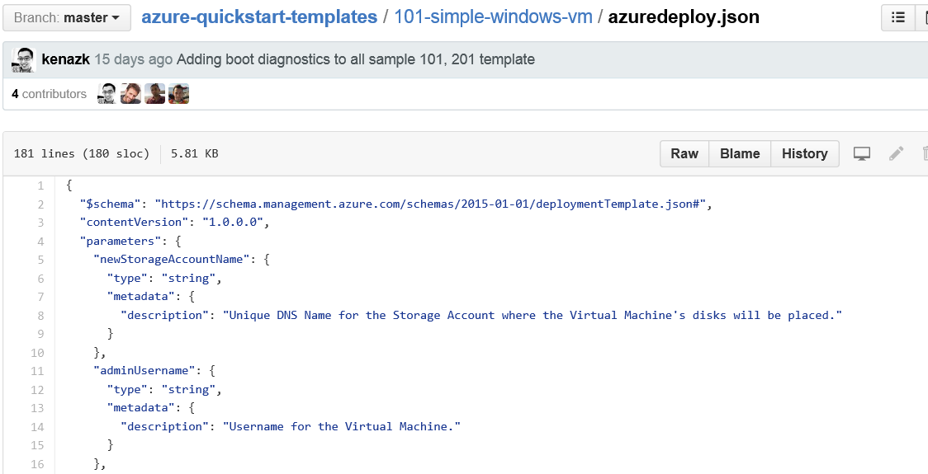
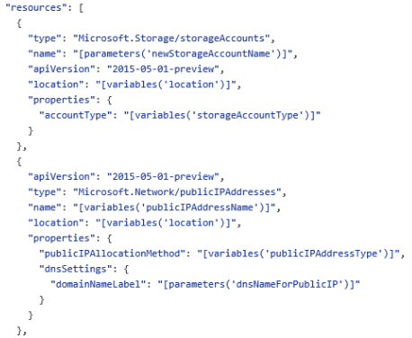
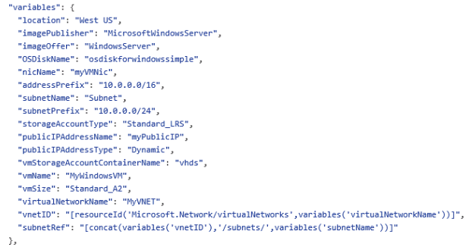
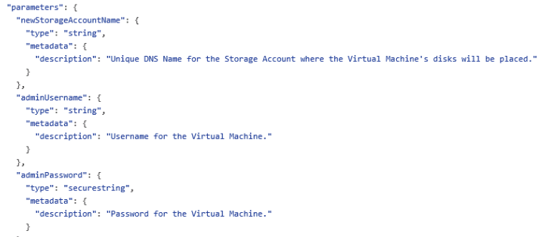
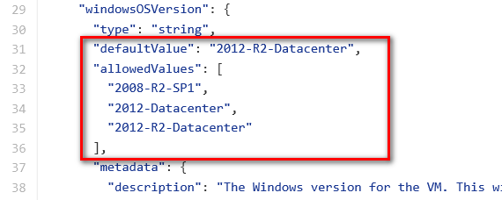
JSON files—simpler than they look Schema, content version, parameters, variables, resources, and outputs

Slide 26


Get started
Visit azure.microsoft.com

